Slide 1
USDS+<agency>+OPM Hiring Pilot SME Training Part 1: Resume Review
<insert date>

Slide 2
Agenda for this session
Learn how to write a good review statement, learn basic principles behind the merit system
Practice resume review
Learn how to record feedback in USA Staffing
REMINDER: Turn in filled out SME Background Info Sheet

Slide 3
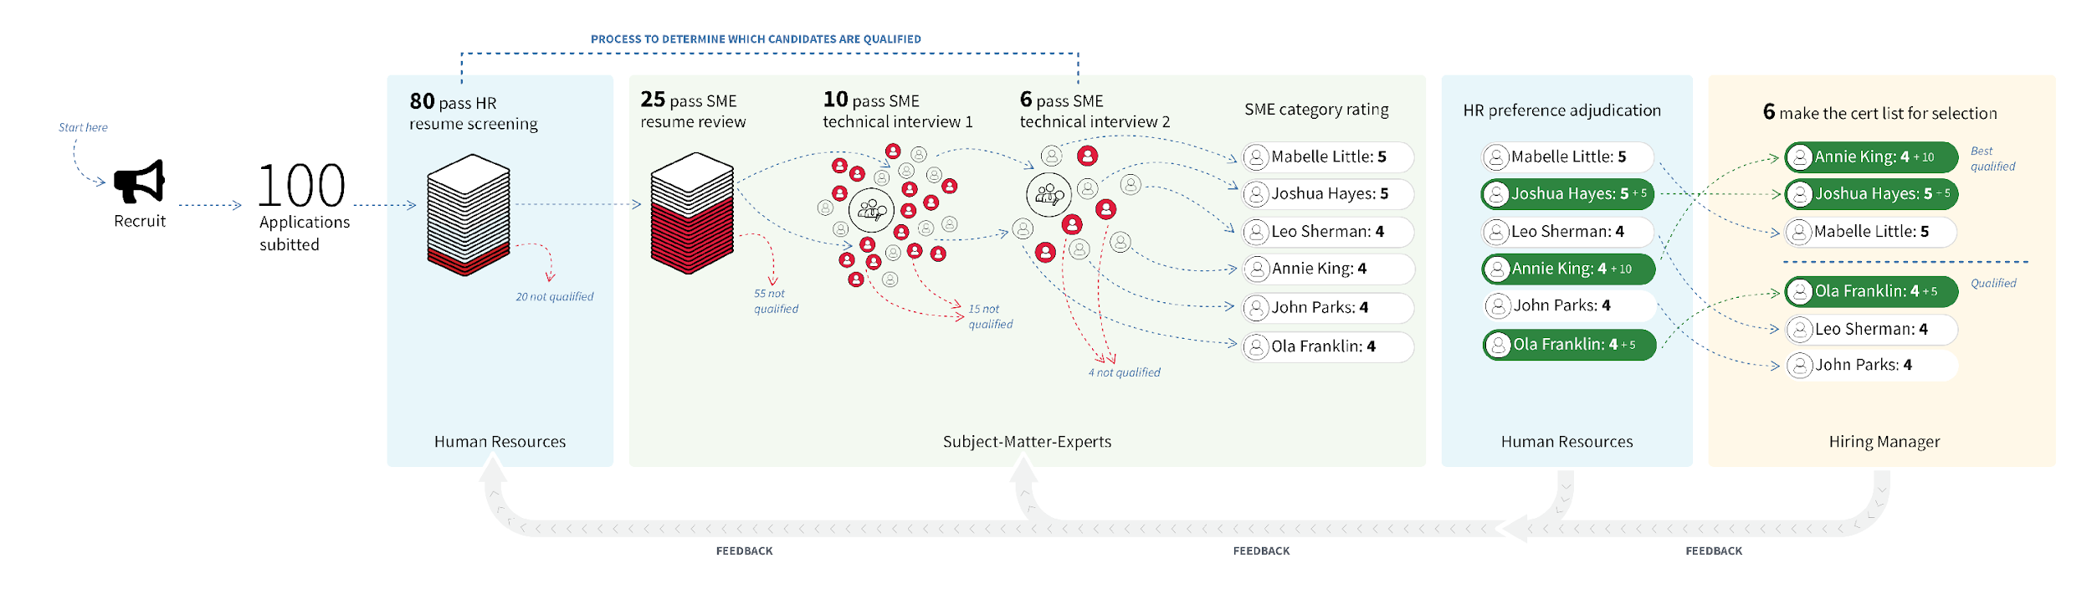
Multi-Hurdle SME Assessment Process
{
You

Slide 4
Resume Review

Slide 5
Time considerations
You are one of two SMEs who will review every resume in your list.
If you are a tiebreaker, you will have additional time to finalize decisions.
We recommend 1 hour blocks of time with breaks in between.
Review should take about 5 minutes and will get progressively easier.

Slide 6
What to look for
Look at the first <X> pages of work experience only.* (might not be pages 1-2)
Verify at least a year of relevant experience.
Look for evidence of the required competencies at the proficiency level specified. Be rigorous.
If additional parentheticals are chosen, evaluate the applicant against the additional competencies/proficiencies.
Do not look for specific keyword matches.
Do not reject for overqualification.
Regarding veterans: Do not make a determination based on veteran status. You are only evaluating applicants against the competencies.

Slide 7
Providing written justification
Include rating with 1–3 sentences tied back to proficiencies.
Mention that applicant has at least a year of relevant experience.
Provide enough detail to retrace decision point later.
If you are deliberating, write it down.
For parentheticals, be clear about which competency you are rating.
Don’t create a checklist of the competencies and proficiencies or find explicit keywords.

Slide 8
Ratings
Move Forward Required competencies and proficiency levels adequately reflected to warrant further evaluation.
Borderline Meets or exceeds most competencies, but remaining competencies could not be accurately assessed.
Does Not Move Forward Required competencies and proficiency levels not adequately reflected; no further evaluation recommended.

Slide 9
Moving an applicant forward
When the decision to move forward is clear, the documentation needed is straightforward. When it’s not clear, the documentation should reflect what assumptions were made.
Resume reflects the competencies and proficiency levels needed with limited speculation.
Resume appears to meet them but you need to make major assumptions.

Slide 10
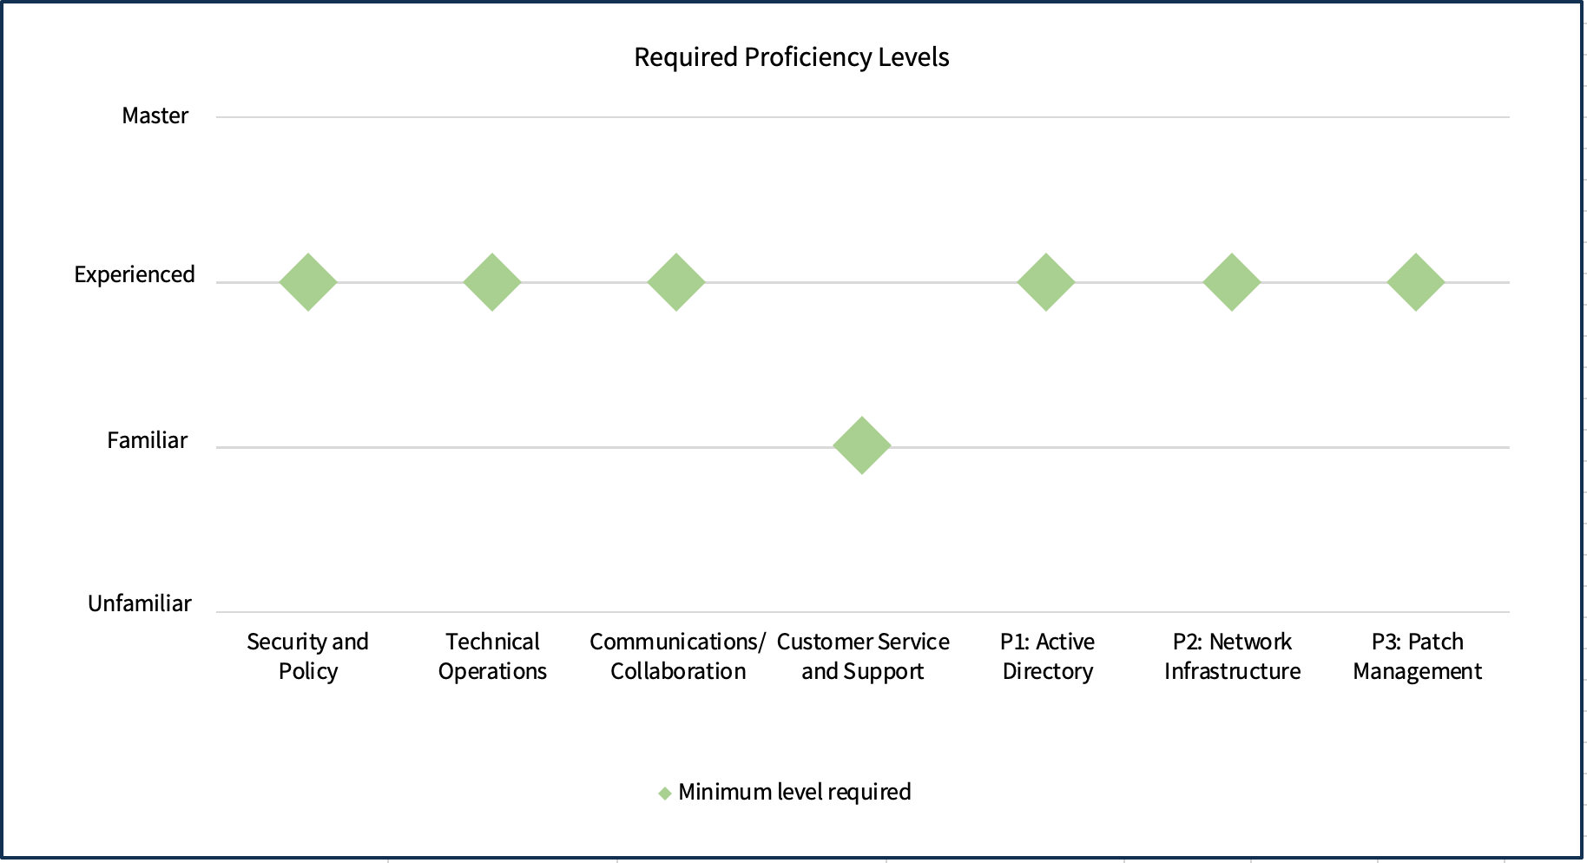
What you have decided for this hiring action
Insert custom chart of the competencies and levels for the new position

Slide 11
Example statement // If resume meets the requirements (with limited speculation)
“Move Forward: Required competencies and proficiency levels adequately reflected for both the Generalist and the Data parentheticals to warrant further evaluation. Duration of experience is met.”

Slide 12
Example statement // If resume meets the requirements (With major assumptions)
“Move Forward (Policy and Planning): It appears Annie has sufficient experience with IT practices, technical communication, analytical ability, and policy. Meets managing without authority and stakeholder engagement because she implemented a company-wide program that had success results and metrics. Duration of experience is met.
Does Not Move Forward (Data Management): Resume shows no evidence of data analysis at the required proficiency level.”

Slide 13
Example statement // Does not move forward
“Does Not Move Forward (all parentheticals): Though Eugene’s resume shows 43 years experience as an IT Specialist, there is no evidence that he is experienced at managing without authority or effective stakeholder engagement at the levels required by the position.”

Slide 14
Example statement // Does not move forward (typos and grammatical errors)
“Does Not Move Forward (Generalist): Kevin’s resume does not show technical communication skills at the level required for this position because it contains multiple spelling and grammatical errors.”

Slide 15
Example statement // Borderline
“Borderline: Though applicant has duration of experience and meets or exceeds most competencies, I am unable to assess managing without authority because I am unable to determine what technical communication skills he might have.”

Slide 16
Prohibited Personnel Practices 5 U.S.C. 2302(b)
Giving an unauthorized preference or advantage to improve or injure the prospects of any particular person for employment
Engaging in nepotism
Discriminating (including discrimination based on marital status and political affiliation)
Considering employment based on factors other than personal knowledge or records of job-related abilities
Influencing any person to withdraw from job competition

Slide 17
Resume Review Practice Session: 60 minutes

Slide 18
What you have decided for this hiring action
Insert custom chart of the competencies and levels for the new position

Slide 19
USA Staffing

Slide 20
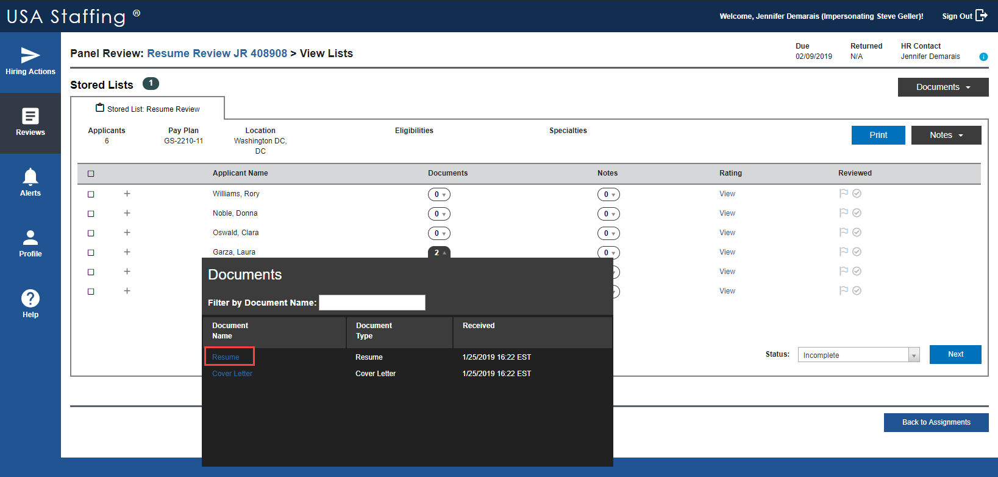

Slide 21
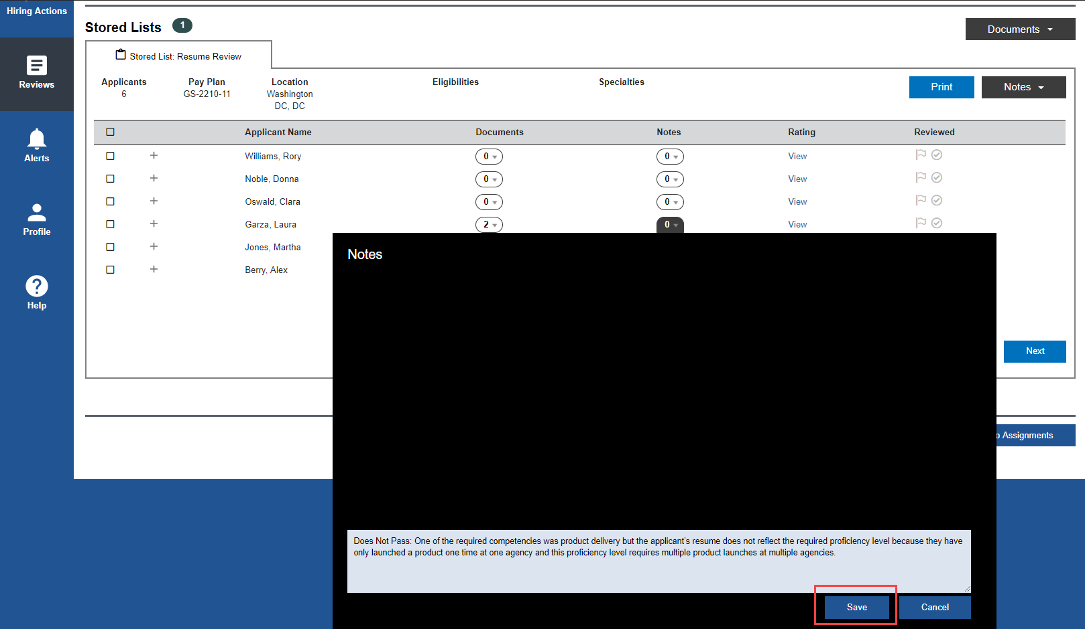
Does Not Move Forward: One of the required competencies is product delivery but the applicant’s resume does not reflect the required proficiency level because they have only launched a product one time at one agency and this proficiency level requires multiple product launches at multiple agencies.

Slide 22
Outcomes
If Tiebreaker, a 3rd SME makes final decision
SME1 Rating | SME2 Rating | Resume Review Outcome
Move Forward | Move Forward | Move Forward
Move Forward | Borderline | Tiebreaker needed
Move Forward | Does Not Move Forward | Tiebreaker needed
Borderline | Borderline | Does Not Move Forward
Borderline | Does Not Move Forward | Does Not Move Forward
Does Not Move Forward | Does Not Move Forward | Does Not Move Forward

Slide 23
Logistics
<REPLACE THIS CONTENT WITH CUSTOM CONTENT>
SME Resume Review Training
May 3 (Friday): 1:00–3:00 EDT
May 6 (Monday): 10:00–12:00 EDT (stay after to review real resumes)
Required for all SMEs
Resume Review: May 6–10 (Sandy, Joyce, Evan, Keith)
Resume Review Tie Breaker: May 15–17 (Tom, Kashif)

Slide 24
The End

